Slide 1

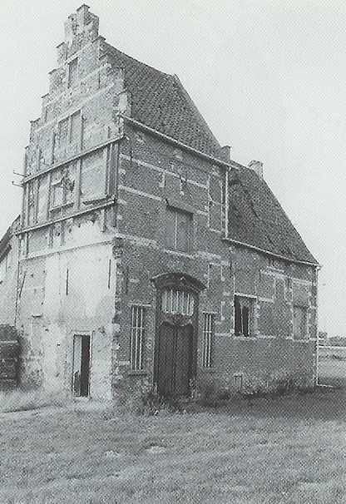




60min
REGULAR EXPRESSIONS
Hands-On
Introduction
TechEvent

Slide 2




For the « Why Regex »
and
All the regex memes
→ Itenium blog

Slide 3



Why Regex
Fuzzy Search
Search & Replace/Delete/Extract
Input Validation
Data Scraping

Slide 4




When to regex
IDE & Text Editors
Databases
Programming Languages
CLI Tooling
Log files, data dumps, …
Git history

Slide 5

When NOT to Regex
Html / Xml
Email addresses
Everywhere

Slide 6


Regex Tooling
See what your regex is matching as you type it
Combine with
grep, sed, awk
Multi cursor
Programming language
Notes:
awk: create reports
sed: parse & transform
grep: match stuff
Multicursor & regex : a match made in heaven

Slide 7
Multi Cursor
Pragmatic Tip 22
Use a single editor well

Slide 8
Multi Cursor
In Visual Studio Code
CTRL + D : select next (CTRL + F2 : select all)
CTRL + U : deselect current
CTRL + K, D : deselect current & select next
CTRL + ALT + UP/DWN: insert extra cursor
SHIFT + ALT + i : Turn selection into cursors
SHIFT + ALT + ←→ : shrink/expand selection

Slide 9
Multi Cursor
In Visual Studio Code
CTRL + Click : select word
SHIFT + ALT + drag mouse : select box

Slide 10


Regex Learning
Resources – See README
Learning resources
Online interpreters
Cheat Sheets
Book « Mastering Regular Expressions »

Slide 11



Regex Tutorial
The absolute minimum one should know about regex to be productive

Slide 12


Regex Tutorial
Literals – match exactly what you type
Metacharacters
^ beginning of a line
$ end of a line
\ escape a metacharacter
. (dot) any character
\< and \> beginning/end of word

Slide 13
Regex Tutorial
Character Classes
[az] match a or z
[0-9] match a digit
[a-zA-Z0-9-] match a number, a letter or a dash
[^az] match anything BUT a or z

Slide 14
Regex Tutorial
Quantifiers
A? – Optional
A* – Zero or more
A+ – One or more
A{1,3} – One, two or three
A{,5} – Zero to 5
A{5,} – 5 or more

Slide 15
Regex Tutorial
Grouping
(a|b) – Alternation (a or b)
(?:non-capturing group)
Backreferences
(\w+) \1 – Match doubled words

Slide 16
Regex Tutorial
More Metacharacters
\d – [0-9]
\w – [0-9a-zA-Z_]
\s – space, \n, \r, \t, …
\b – \< or \>
Reversed: \D – Not a digit

Slide 17
Regex Tutorial
Modifiers
g – global
i – case insensitive
m – multiline (^$ vs \A\Z)
s – dotall (dot matches \r\n)
There are more, depending on the flavor
Notes:
G(lobal): Match more than once (ex: JavaScript regex replace)
m(ulti mode): \A & \Z to match beginning/end of the entire string vs ^ and $ match every line

Slide 18
Regex Tutorial
Replacement
$1 – First capturing group ($2, …)
$` – Before matched string
$’ – After matched string
$& – Entire matched string
Some flavors use \ instead of $

Slide 19
Regex Tutorial
Lookaround
Match a position, not the text
Lookahead (right)
Lookbehind (left)

Slide 20
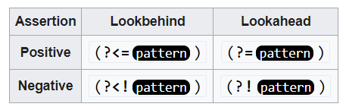
Regex Tutorial
Lookaround

Slide 21
Regex Tutorial
Lookahead (most common)
A(?=B) – A followed by B
A(?!B) – A not followed by B
In these examples, only A will be captured

Slide 22
Regex Tutorial End
There is (a lot) more…
Differences in flavors really become obvious

Slide 23
Closing Note
Find the balance between exactness vs vagueness
Exactness: larger regex, more difficult to read
Vagueness: simpler regex, might match too much
Vague: \d{2}.\d{2}.\d{4}
Exact: \d{2}[/.-]\d{2}[/.-]\d{4}
Notes:
Vague: might match a large number
Exact: need to adjust the regex when more date separators are used

Slide 24
REGULAR EXPRESSIONS
EXE RCISES

Slide 25



THANK YOU!

Slide 26

WiFi: itenium-guest / Wifi4Ufree

